Slide 1
Web engineering
Responsive Design

Slide 2
Target

Slide 4

Alternative to responsive design

Slide 5
12-column grid responsive layout

Slide 9
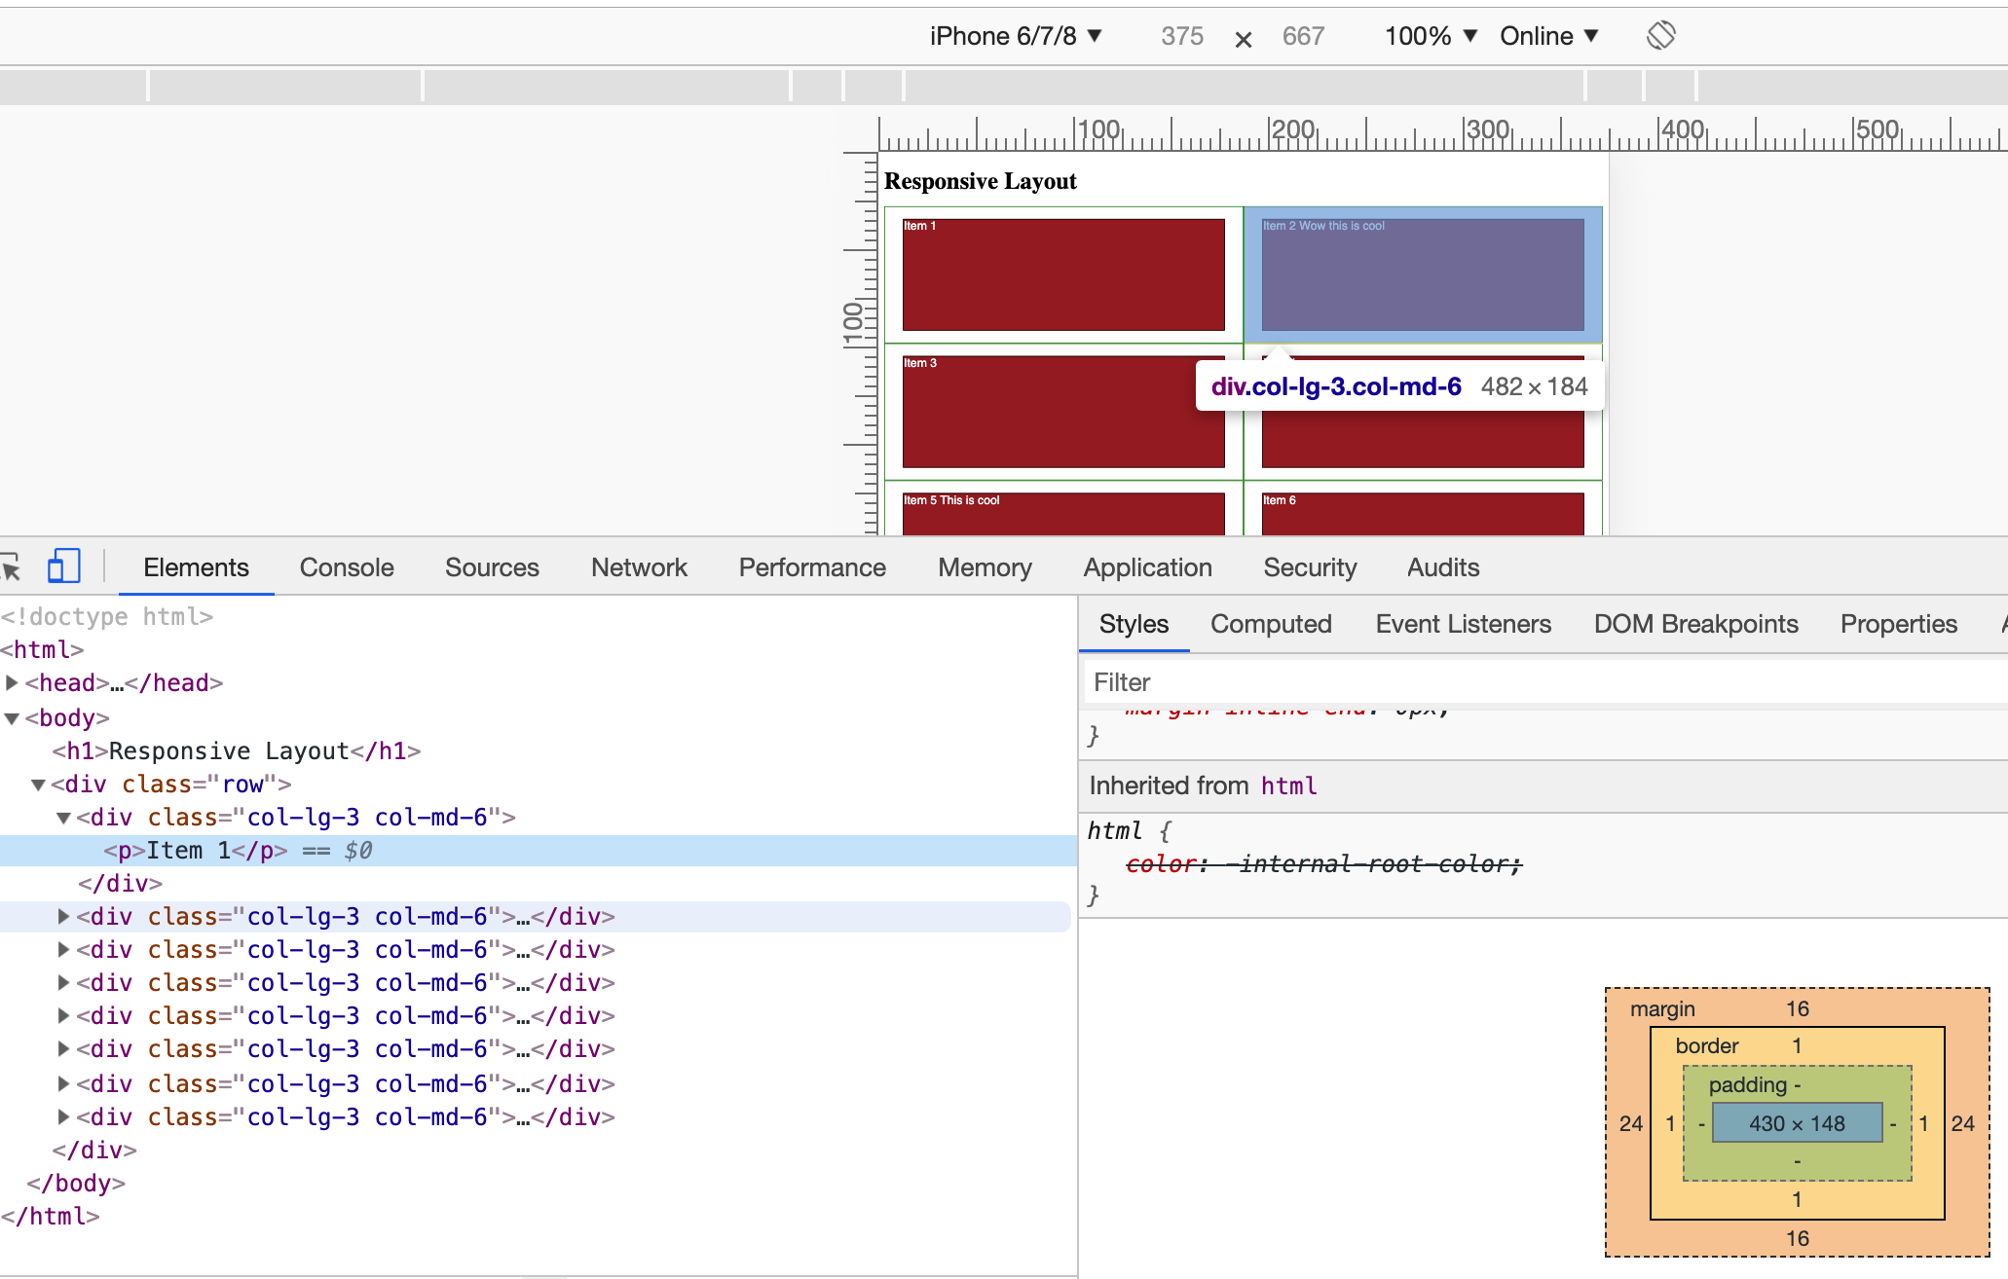

Slide 10
